Slide 1
Poetry & Neural Networks
Cora Hickoff

Slide 2
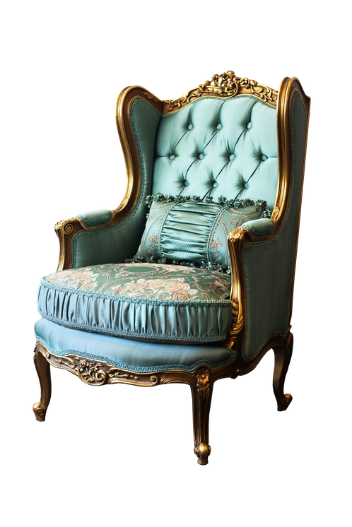
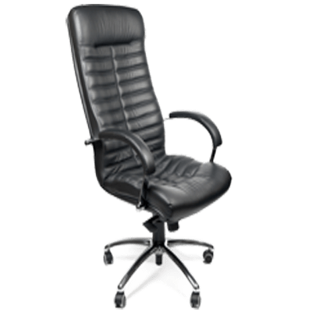
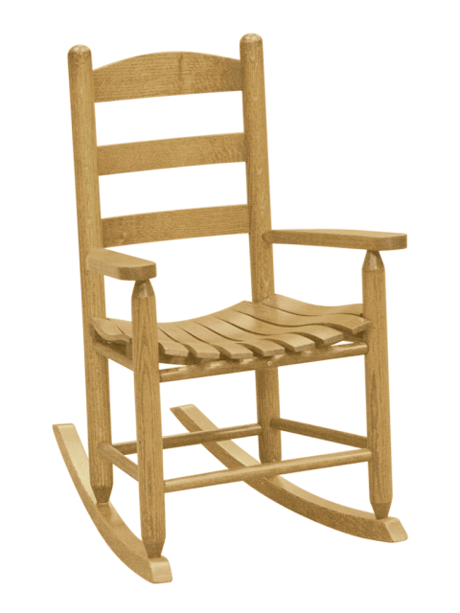
There’s a room full of people. Tell them to “Imagine a chair,” and everyone visualizes something different.

Slide 3
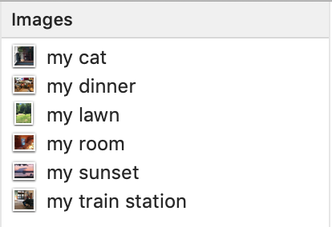


What if their visualization became a physical space?
Every time a person read a line of poetry, the network would capture what their mind saw, and the image gets put in a space. By the end of the poem, the accumulated images would became a location anyone could visit.
You’re free to visit all the editions over time.

Slide 4
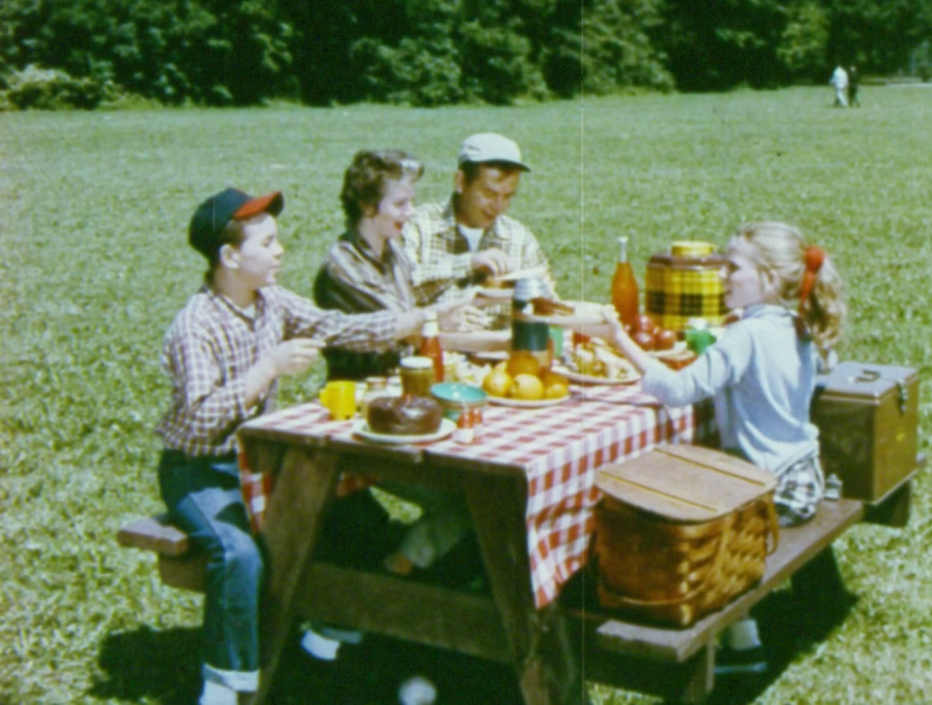
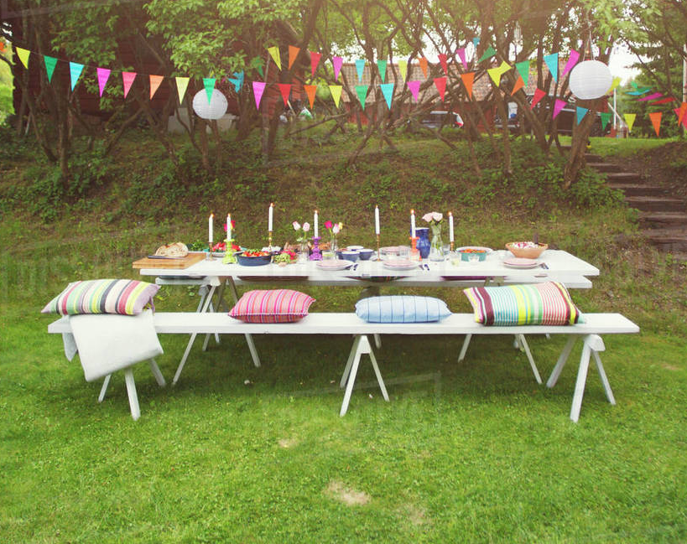
After fully reading a poem, a new location would be generated. Over time, you can go back to how you saw the poem before, no matter how long ago.
The locations change as your experience other peoples’ visualizations of the same poem.
You could visit “John’s” idea of that poem, but also visit a version of your poem that brought in his idea of a picnic table.
Each iteration of the poem will automatically save as a new version
Left: My picnic table
Right: John’s picnic table

Slide 5
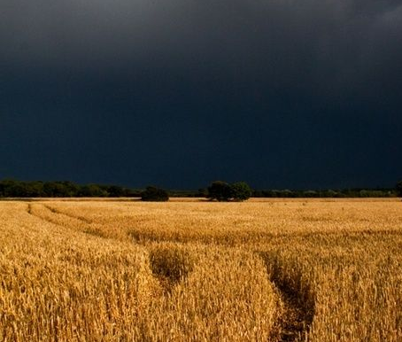
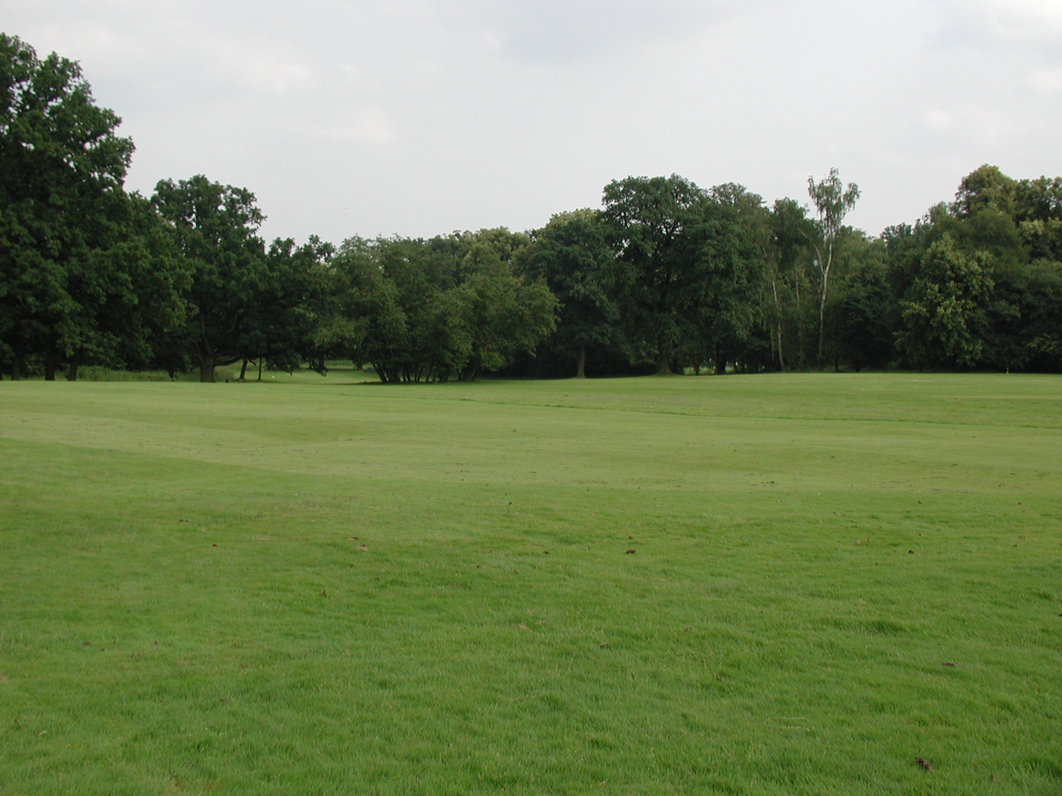
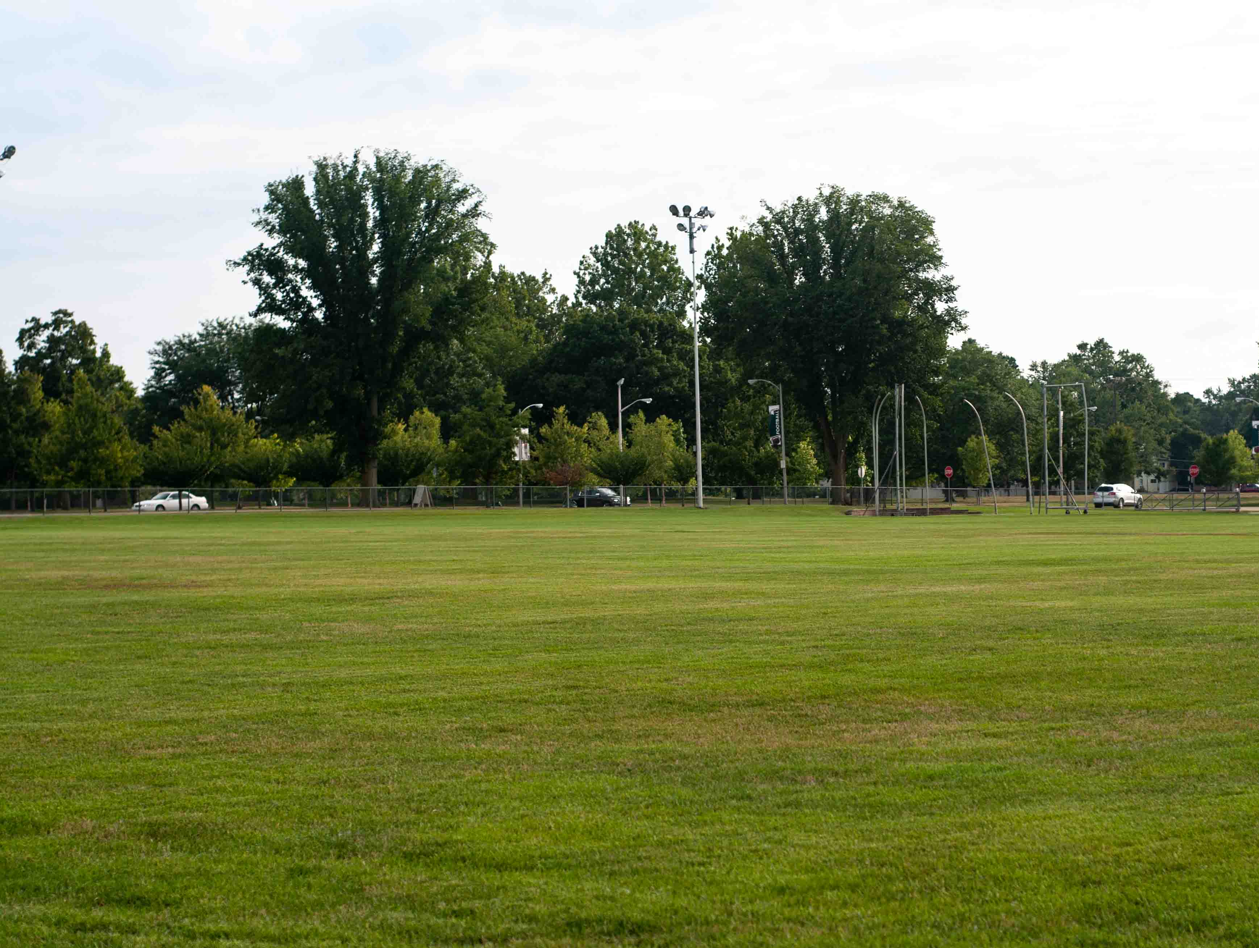
If your image and the image generated by another person were similar, the network would find someone whose image is different, so as to help you see a new perspective. You are both given Phoebe’s visualization of a field.
Phoebe’s field

Slide 6


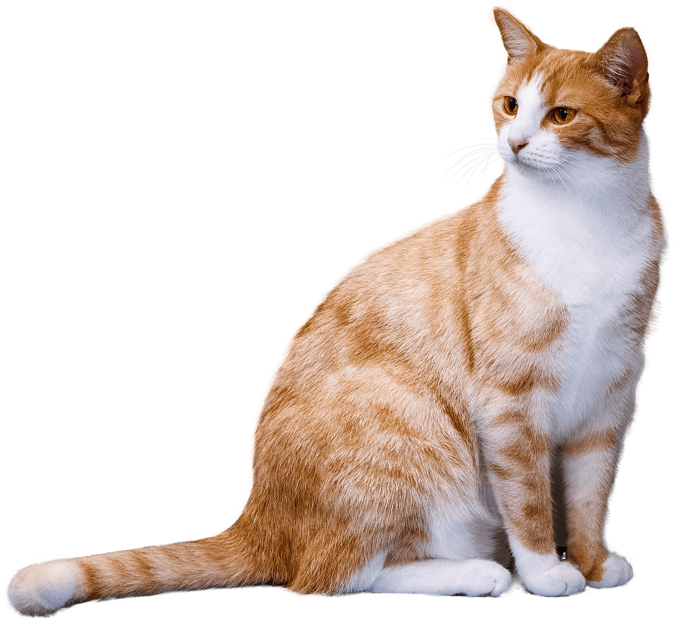
If you’re with a group of people, you would all read the same poem. Everyone will see something different.
Then, you all reread the poem. Each time you reach a certain word, it acts like a trapdoor and the network decides whose previous visualization you see.
Ex: the word, “Cat” would be a trapdoor, and someone else’s visualization of the word would enter your poem’s location.

Slide 7
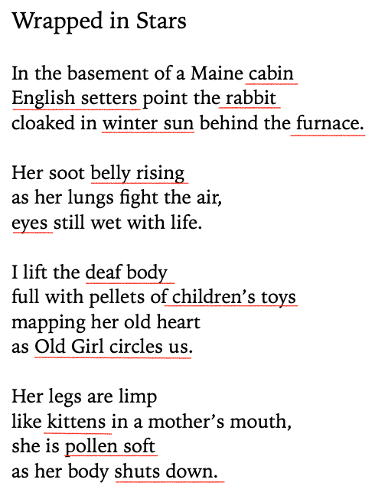
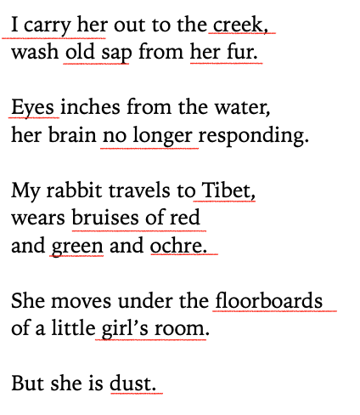
Underlined words and phrases would act as trapdoors
Poem by Cora Hickoff

Slide 8



Ultimately, this network’s is about letting people visit past versions of themselves. This is done through saving images and spaces they imagined when reading poems. These spaces will ideally feel lifelike. Each environment will have sounds, smells, and let its visitors move around and touch the space.
Since smell is closely tied to memory, these environments could help people retrieve once forgotten memories from the time they visualized and experienced these imagined spaces.

